Slide 1

amara
an open-source, free-to-use subtitling platform
Test Framework designed and written by:
Team Tardigrades
Austin Hollis, Rowen Loucks, Jason Boulware, Jeffery Williams

Slide 2
About Amara
Amara is an award-winning open-source subtitling platform
It allows users to cooperate and submit subtitles for videos in any language
Commercial options available for large-scale projects
Professional translators also on-demand
Goal: increased accessibility and cultural collaboration
Project of the Participatory Culture Foundation

Slide 3

How Does It Work?

Slide 4
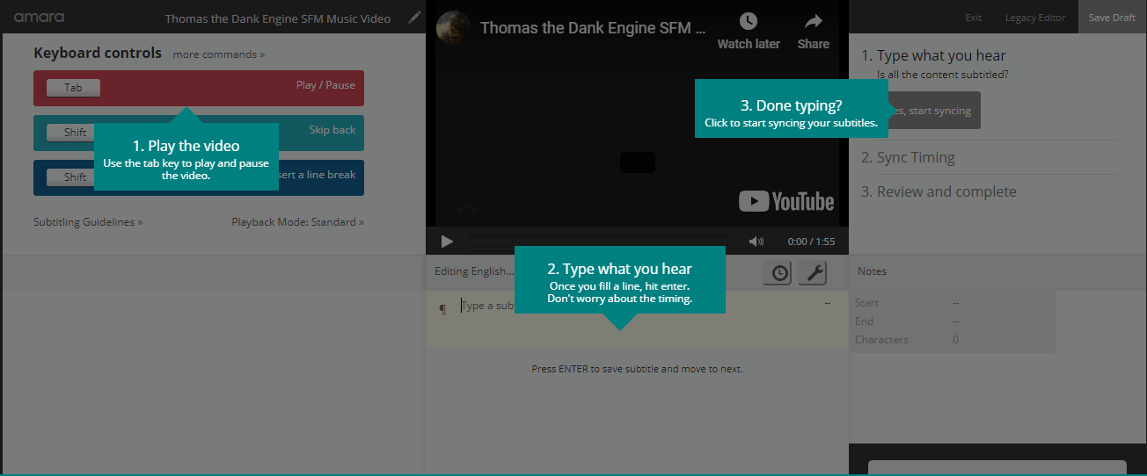
The Platform
Browser-based
Users add a language and subtitles for that language
Videos posted either publicly or privately on their website

Slide 5
Development Issues
Frequent GitHub commits - very difficult to remain up-to-date
Numerous dependencies from varied sources
Python libraries, Linux packages, many of which are hardcoded and difficult to resolve if they are depreciated
Poor, difficult to access documentation - many dependencies are unlisted, minimal comments in files, little description
Developers acknowledge that the project is difficult to pick up and assist, particularly so for an FOSS project

Slide 6
Designing Our Framework
Difficulties:
Docker container
Handles all primary functions through docker-compose bash commands
Circular references
.py files import from other .py files, which depend on .py files that import from the first set of .py files
Difficult to navigate and compile without the docker image
Solutions:
“Black box” unit testing
Minimize dependencies in tested files

Slide 7
TEST CASES

Slide 8
File Type Identifier Methods
isVideoFilename
Check file extension to verify file is a video (and can thus be processed)
isAudioFilename
Check file extension to verify file is an audio file
isTorrentFilename
Check file name to verify file is a torrent file
isAllowedFilename
Check file extension to verify it can be processed by Amara’s platform

Slide 9
Special Cases: guessExtension and guessMimeType
guessExtension:
Method that guesses the extension of a file based on its medium
Example: quicktime videos use .mov file extension
guessMimeType:
Method that guesses the media type of a file given its file name
MIME type: formerly Multipurpose Internet Mail Extensions - now “media type”

Slide 10
Other Utilities Tests
escape_ampersands:
replace ‘&’ with ‘&amp;’ for html processing
fraction_to_milliseconds:
converts a string of milliseconds into an integer string with 3 digits; returns 0 if the input is already > 3 digits
get_current_commit_hash:
return the git commit hash for the current commit

Slide 11
FAULT
INJECTIONS

Slide 12
Fault 1: Function fraction_to_milliseconds
###Original### def fraction_to_milliseconds(str_milli): if not str_milli: return 0 ... ... ###Fault Injection### def fraction_to_milliseconds(str_milli): if not not str_milli: return 0 ... ...

Slide 13
Fault 3: isAllowedFilename
Fault 2: centiseconds_to_milliseconds
##Original### def centiseconds_to_milliseconds(centi): return int(centi) * 10 if centi else 0 ###Fault Injection### def centiseconds_to_milliseconds(centi): return int(centi) * 10 if 0 else centi
###Original### def isAllowedFilename(filename): return isVideoFilename(filename) or isAudioFilename(filename) or isTorrentFilename(filename) ###Fault Injection### def isAllowedFilename(filename): return isVideoFilename(filename) and isAudioFilename(filename) or isTorrentFilename(filename)

Slide 14
Fault 4: isAllowedFilename
###Original### def isAllowedFilename(filename): return isVideoFilename(filename) or isAudioFilename(filename) or isTorrentFilename(filename) ###Fault Injection### def isAllowedFilename(filename): return isVideoFilename(filename) and isAudioFilename(filename) and isTorrentFilename(filename)

Slide 15
Fault 5: can_view_activity
###Original### def can_view_activity(user, viewing_user): return ( user == viewing_user or viewing_user.is_superuser or user.created_by == viewing_user ) ###Fault Injection### def can_view_activity(user, viewing_user): return ( user == viewing_user and viewing_user.is_superuser or user.created_by == viewing_user

Slide 16
DEMO TIME!!

